Slide 1
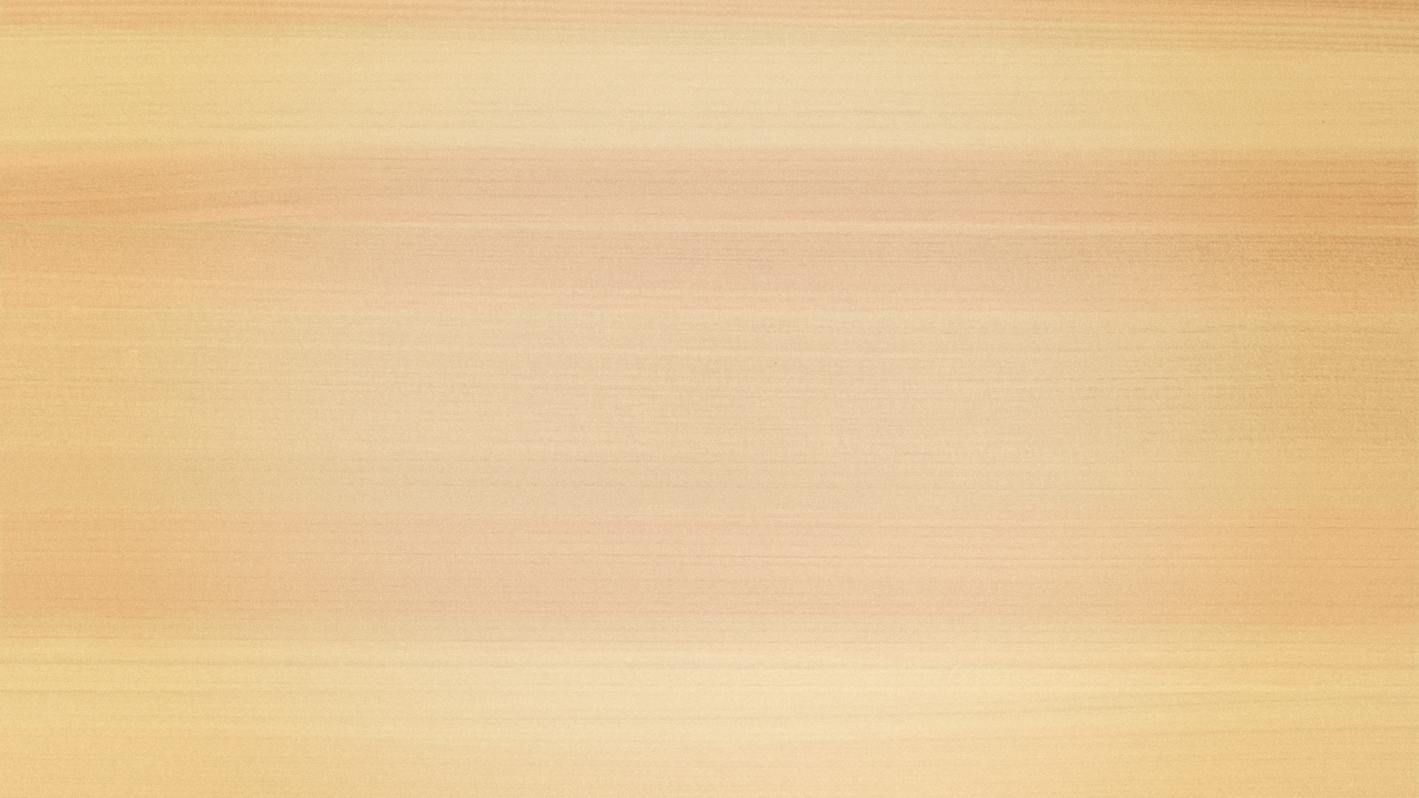
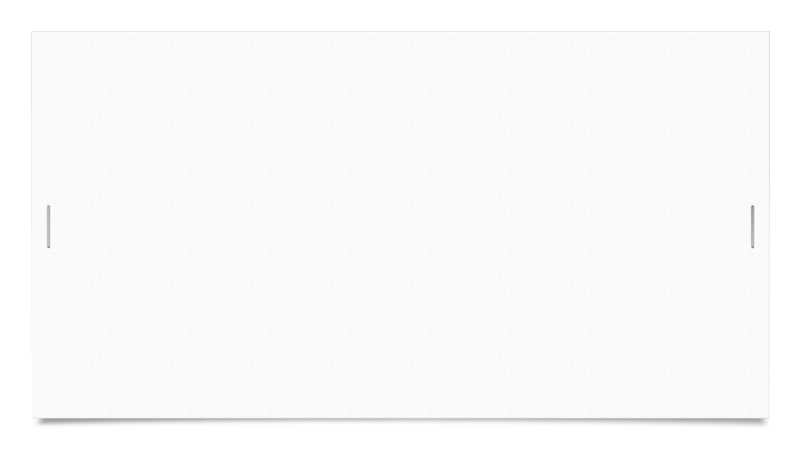
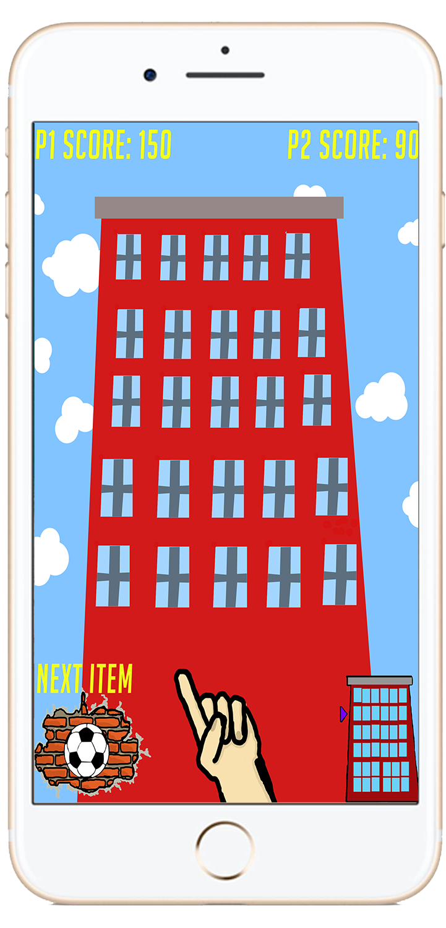

Game Mock up.
Played in portrait mode
Stylised HUD to fit the theme
Tall, Narrow building to fit the screen
Notes:
Narrow and Tall building to fit on the screen.
Portrait mode as this will allow the building to fit on the phone properly without any in game camera movements..
All the information that you need to play is at the bottom of the screen, this leaves more space for the building and the many windows.
Powerbar and aiming stylised to fit the theme of the game.
Players score displayed at the top of the screen and can be seen at a glance.

Slide 2
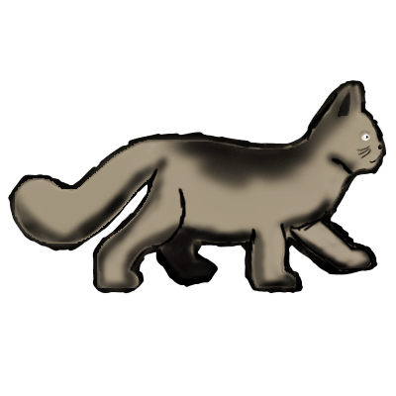
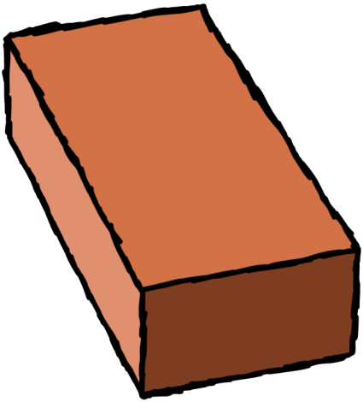
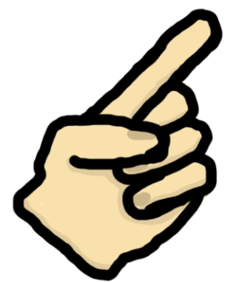
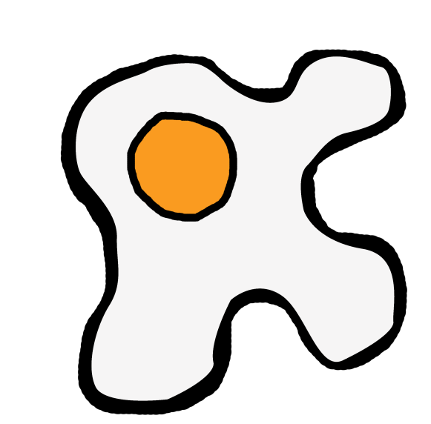
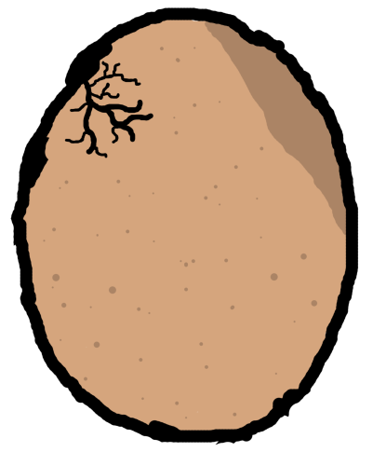
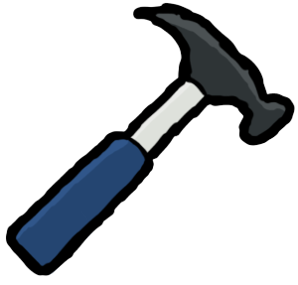
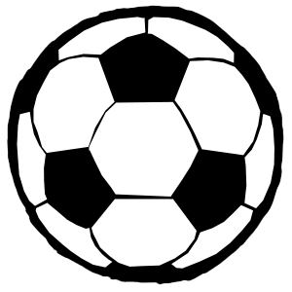
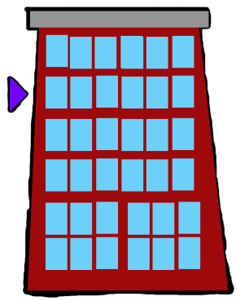
Art Style
Cartoon Style
Hand Drawn
High Value Colours
Would interest both older and younger players.
Notes:
Our Hand Drawn Cartoon art style should Appeal to most audiences since it’s not ultra-realistic meaning that the younger demographic would like the look of it as well as the older demographic.
This style also makes the game seem more like slapstick violence, adding to the comedic side of the game and retracting it more from real life.
Assets that we have are yet to be implimented into a prototype.

Slide 3
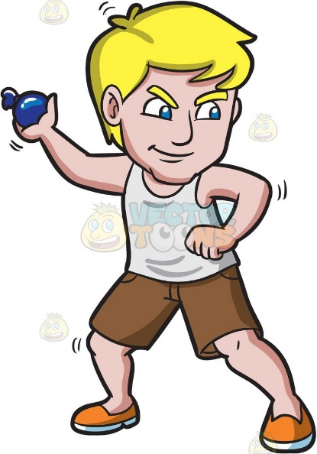
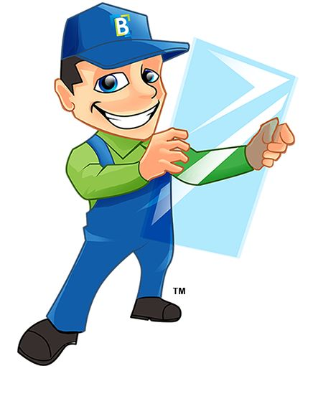
Future Assets
Window Events
Animations
More throwable objects
Notes:
For further versions of the game we need to create the art assets for the random window events such as people in the windows and people trying to fix the windows. Another possible set of assets that we could make would be to add more throwable items for the player to use in order to create a bit more variety in the gameplay, even if they’re not affecting the gameplay directly the aesthetic change would be interesting to the player.
We also need to work on some animations for throwing the objects and the window smashing along with the people moving into positions behind the windows.

